Slide 1

About Perfect Way Mobile (PWM)
30
Operational & ongoing outlet locations and more to come
160+
Talented & professionally trained personnel
10+
Years of retail experience & expertise
Fair networking & geographical distribution in UAE

Slide 2
Our Vision
Enrich customers' lives and make their livelihood more successful by providing premium, powerful and beneficial communication solutions.
PWM Mission Statement
  Live with our partner values by providing professional and innovative customer solutions
  Perfect Way aims to be leading mobile operator in UAE, providing professional, world-class mobile and data services to all our customers

Slide 3
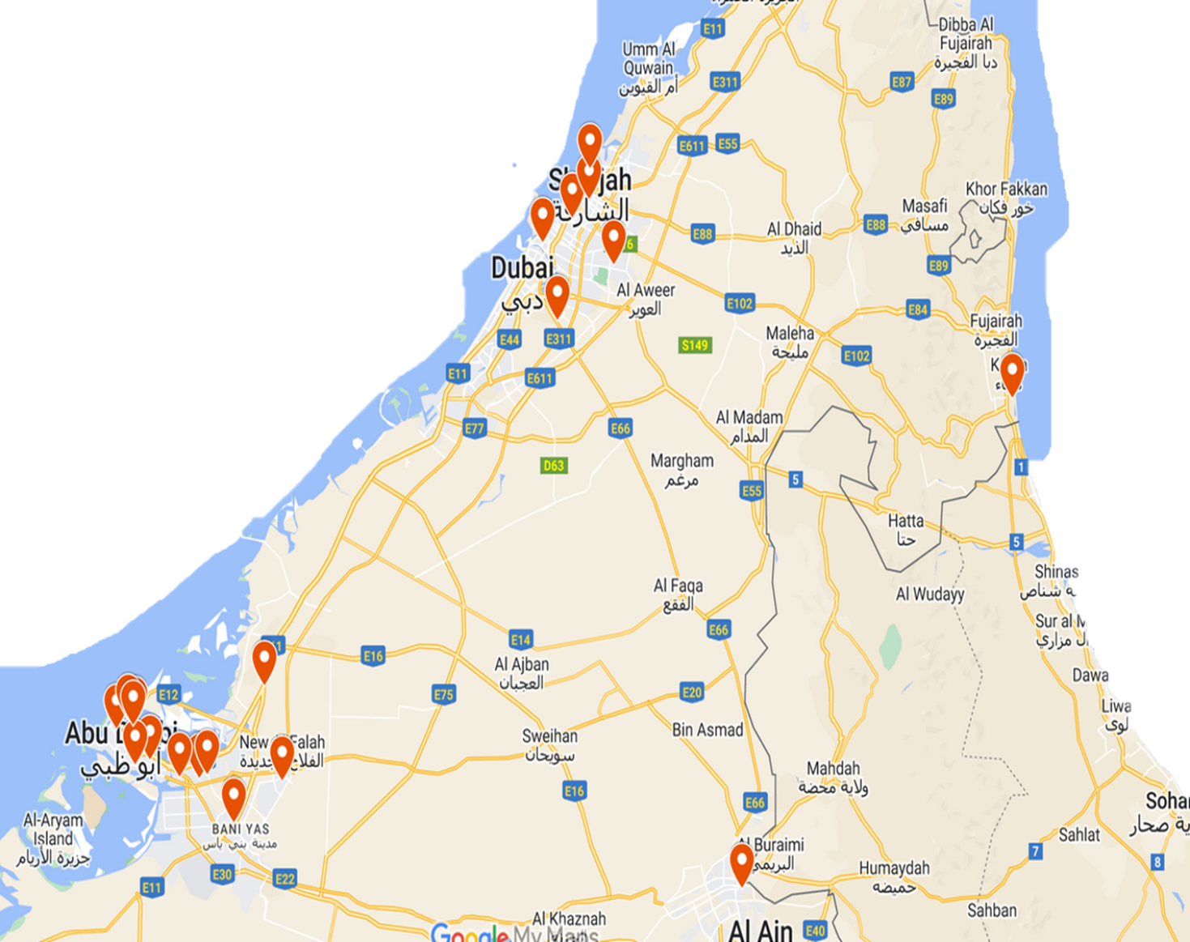
Perfect Way Networking & Distributions
Al Shawamekh Central Mall – AUH
Madinat Zayed Shopping Centre – AUH
Forsan Central Mall – AUH
The Galleria Mall – AUH
Madinati Mall – AUH
Bani Yas Coop – AUH
Al Shamkha Mall – AUH
Al Reem Mall – AUH
Souq Al Sarab – AUH
Al Rabdan Mall – AUH
Al Falah Mall – AUH
Capital Mall – AUH
My Town Centre – AUH
Lulu Al Dhafrah MZ – AUH
Maktoum Heritage Souq – DXB
Last Exit Al Khawaneej – DXB
Avenue Mall – DXB
DIFC – DXB
Emirates Group HQ – DXB
Nad Al Sheba Mall – DXB
Etihad Mall – DXB
Matajer Mirgab – SHJ
Kalba Mall – SHJ
Sharjah Central Mall – SHJ
Al Suyouh Mall – SHJ
Union Coop – UAQ
RAK Mall – RAK
Galila Mall - RAK
Lulu Fujairah – FUJ
Barari Mall – FUJ

Slide 4
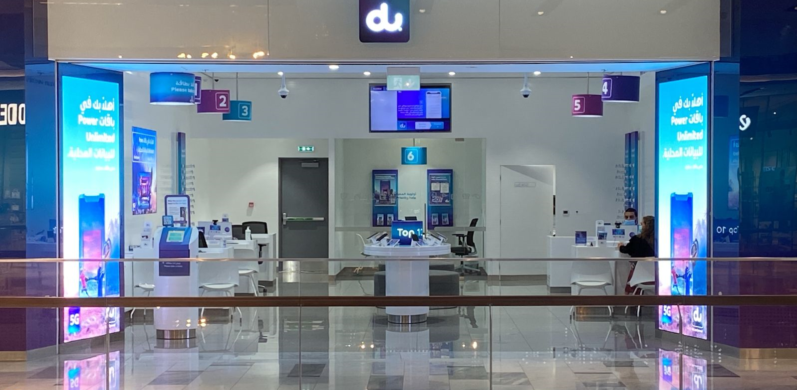
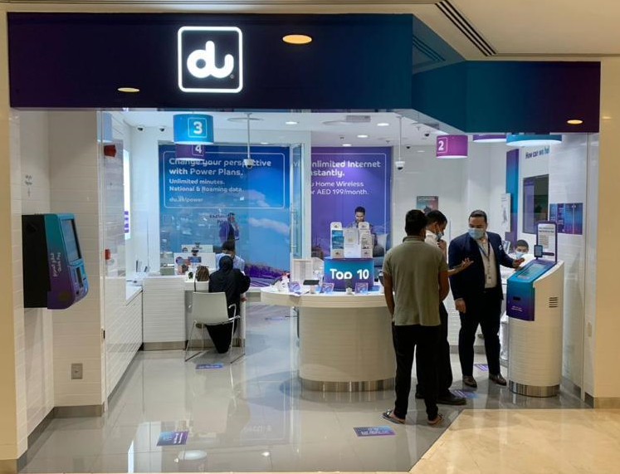

Slide 5
Perfect Way Mobile Strategy
- Answer CSTs inquiries in timely manner.
Build up a proper relationship with CSTs and ask for referrals and keep relations to ensure continuous productivity.
Quality call back check to be done after closing the deals to stand on customer satisfaction.
Utilize Team experience and available tools to sell all products to maximize profitability.
Reduce Claw Back by monitoring quality of sales.
Profit & Loss Evaluation.
Differentiate in Customer Experience
Partnership Management
Operational Excellence
People Development
Market Share Expansion
Maximize Sales & Profitability
Effective Win-Win partnership.
Targeting high standard of quality and productivity to move to the top of business partners.
Make sure to support the partnership success by achieving all assigned KPI’s.
Support all company products.
Monitor TDRA roles and make sure that all terms and conditions shall be filled.
PWM
Strategy
Utilize sister companies data base as sales opportunities.
Have a proper & rational roadmap that supports business needs and du goals.
- Process Efficiency
Zero Wrong Transactions.
Zero Wrong Information.
Quality assurance through after sales calls.
Enough spaces and quite atmosphere to keep the brand image.
Well trained staff.
Enhanced staff awareness to ensure constant level of knowledge and professionalism.
Attractive incentive scheme to keep team motivated.
Connect incentive to QOS to ensure genuine sales.

Slide 6
Key Accountabilities
Operations
Spacious office in the heart of Abu Dhabi.
Individual laptops.
AVAYA System.
End-to-end security for confidential files and recordings.
Professional HR System and advanced software.
Sales
Utilization of all areas of strength with the available tools to meet the assigned KPIs.
Enhance cross-sell concept.
Deepen the relationship and enrich the loyalty level with Du customers.
Ongoing market research to identify the best approach towards expansion.
Internal Audit
Comprehensive auditing structure to ensure that confidentiality and compliance policies are well attended.

Slide 7





Perfect Way Mobile Competencies
CUSTOMER FIRST
Customer Focus
Ensures Accountability
KNOWLEDGEABLE
Business Insight
Decision Quality
ENTERPRISING
Manages Ambiguity
Fosters Innovation
COLLABORATIVE
Collaborates
Courage
TRUSTED
Instils Trust
Demonstrates Self-Awareness
Develops Talent

Slide 8
Thank You

